Slide 1
AI-Powered Regional Air Quality Tracker & Forecasting Assistant
Name – Aman kumar
College name – Mangalmay institute of Management and technology
AICTE Student Id – STU68b1a15bcf2731756471643
Email id – thefirstians1@gmail.com

Slide 2
SDG Alignment
UN Sustainable Development Goal 11: Sustainable Cities & Communities
Target 11.6: Reduction of Urban Environmental Impact
SDG Target 11.6: "By 2030, reduce the adverse per capita environmental impact of cities, including by paying special attention to air quality and municipal and other waste management.
"Official Indicator 11.6.2: Annual mean levels of fine particulate matter (e.g., $PM_{2.5}$ and $PM_{10}$) in cities (population-weighted).
Custodial Agency: World Health Organization (WHO)

Slide 3
Problem statement
The Core Problem:
Technical Intimidation: Raw environmental metrics ($PM_{2.5}$, $PM_{10}$, $NO_2$) are constantly collected by sensory arrays but mean very little to the average citizen or municipal policymaker without context.
Lack of Predictive Foresight: Standard monitoring tools report purely historical data. They tell communities what the air quality was, rather than forecasting what it will be based on changing meteorological inputs.
Static vs. Dynamic Systems: Most solutions lack regional specificity, forcing broad city-wide assumptions instead of micro-regional, zone-specific guidance.

Slide 4
AI Solution Overview
Bridging Raw Climate Metrics with Predictive Machine Learning
In-Memory Data Pipeline (Input)
Extracts localized environmental repositories instantly from an embedded 5 MB deployment bundle (delhi_pollution.zip).Cleans, normalizes, and binds real-time parameters: $PM_{2.5}, PM_{10}, NO_2$, Temperature, and Humidity. Employs One-Hot Encoding to handle zone-specific variables dynamically.
2. High-Performance ML Core (Process)
Powered by an optimized, multi-threaded Scikit-Learn Random Forest Regressor.Scaled to 20 structural decision trees with a capped depth limit (max_depth=12) for lightning-fast execution in cloud containers.Maps nonlinear environmental feature correlations to predict localized AQI values instantly.
3. Actionable Intelligence Engine (Output)
Renders a highly polished, responsive interface using the Streamlit web architecture.Dynamically maps predicted index values to color-coded, real-time warning cards.Automatically generates action-oriented, UN SDG-aligned health advisories.

Slide 5
Expected Impact
01 / Direct SDG 11.6 Compliance: Successfully bridges the implementation gap by providing localized, predictive air safety data instead of lagging, city-wide historical summaries.
02 / Proactive Public Health Alerts: Translates raw variables ($PM_{2.5}, PM_{10}, NO_2$) into instant, color-coded medical and lifestyle advisories, protecting vulnerable demographics.
03 / High-Speed Cloud Deployment: Proves that machine learning engines can be embedded into optimized, low-cost cloud containers running on negligible server infrastructure.

Slide 6
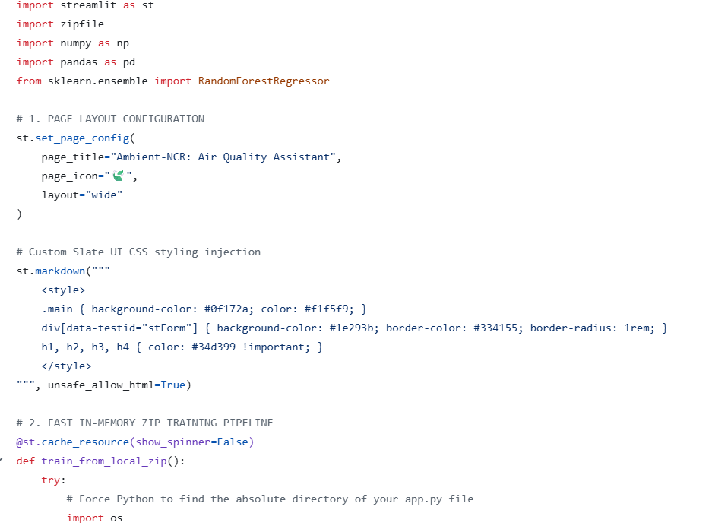
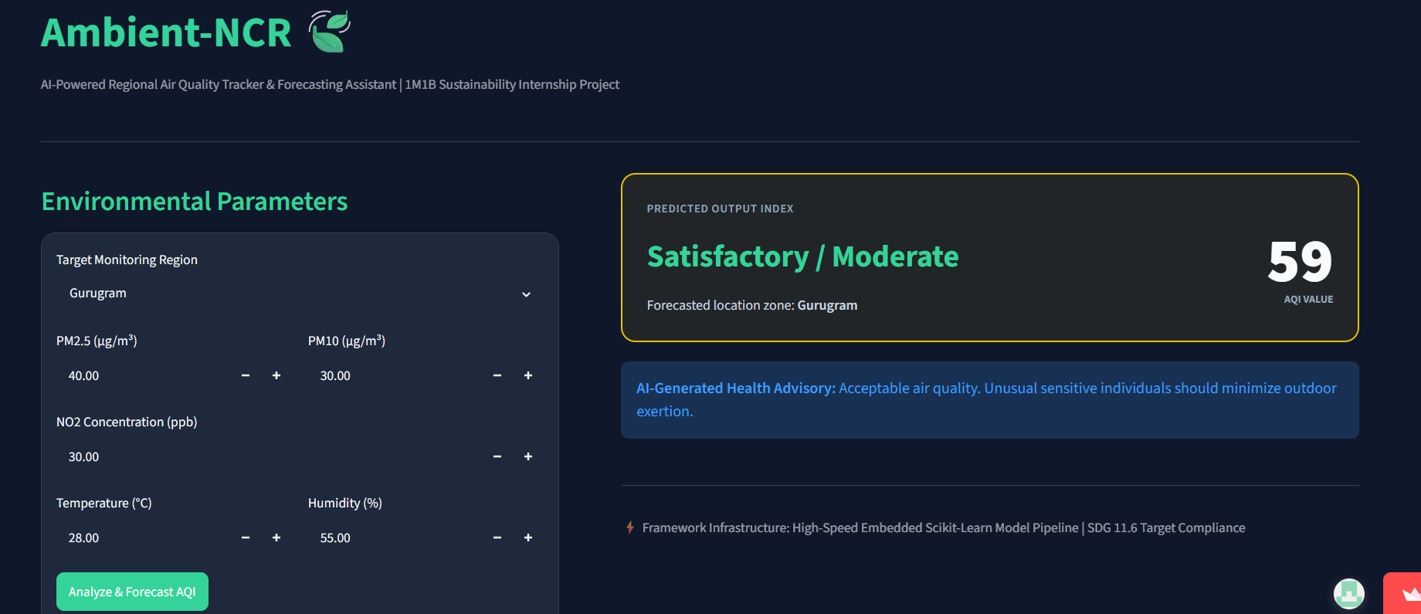
Screenshots

Slide 7
Prototype and Repository
Github Repo Link:- https://github.com/CoderforLife-AK/Ambient_Ncr.git
Prototype Website :- https://ambientncr-mlproject.streamlit.app/

Slide 8
Who benefits and How?
Everyday Citizens & Vulnerable Demographics (Primary)
Proactive Protection: High-risk groups (children, elderly, asthmatics) receive clear, localized early warnings instead of lagging city-wide data.
Actionable Advice: Translates abstract data ($PM_{2.5}$, $PM_{10}$, $NO_2$) into immediate lifestyle guidelines (e.g., advising N95 masks or closing windows).
Zero Technical Barrier: Anyone can get an instant, easy-to-understand health status without reading complex scientific charts.
2. Municipal Planners & Public Health Authorities (Secondary)
Localized Insight: Shifts focus from broad, regional assumptions to zone-specific, micro-regional air variations.
Data-Driven Choices: Gives civic teams quick, predictive insights to guide localized smog control or traffic measures.
Low-Cost Infrastructure: Offers a highly optimized, open-source prototype that runs efficiently on lightweight cloud servers with zero data storage costs.

Slide 9
Thank You

